Slide 1

Code Refactoring And Bug Fixing
By Cherukupalli Indhu

Slide 2

About me:
I hold both a Bachelor of Science and a Master of Science degree.
To improve further in Statistics and to apply the methods of Statistics.
My academic journey has equipped me with a robust foundation in quantitative analysis, problem-solving, and critical thinking skills.
Throughout my studies, I specialized in Statistics , gaining expertise in Decision - Making.
I Interested in Analysis field.
Has of know I did not have any experience.
My career aspiration is to become a Data Scientist.
I aim to leverage my academic background and technical skills to extract actionable insights from complex datasets.
As a data scientist, I am eager to tackle real-world challenges, develop innovative solutions, and contribute to data-driven decision-making processes.
I am excited about the opportunity to apply advanced analytical techniques and machine learning algorithms to solve diverse problems and drive business value.

Slide 3
Scenario:
A team of enthusiastic data scientists embarked on a mission to develop a Note Taking
application using Python, Flask, and HTML.
However, their lack of experience in backend development has led to challenges in making the application fully functional.
Recognizing your proficiency in backend development, you have been tasked with fixing the broken code and ensuring the application works seamlessly.
Task:
Refactor the existing codebase and ensure the proper functioning of the Note Taking Application.
Document all identified bugs during the debugging process.
Remember, the task is not about recreating the app from scratch.
Your goal is to fix the already existing codebase and make the application work as intended.

Slide 4
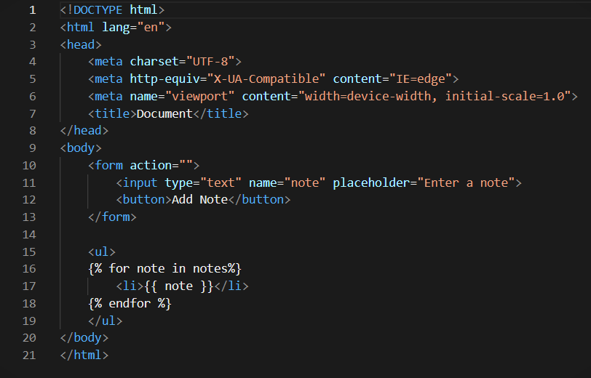
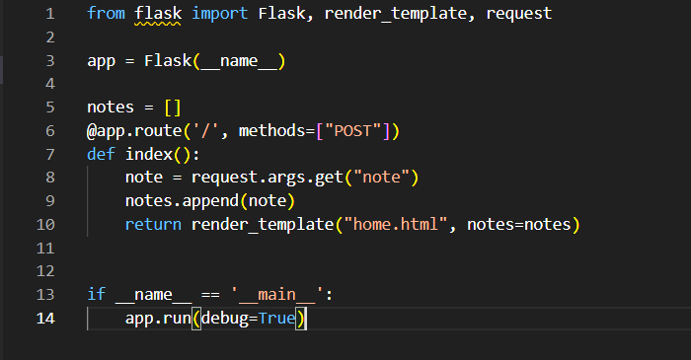
Identifying and Resolving the Bugs in the initial Code:
The following code snippets represents the initial state of Flask Application.
The figure 1 and 2 contains identifiable Bugs , which is Impacting the functionality.
Therefore we need to make the necessary changes to execute It.

Slide 5
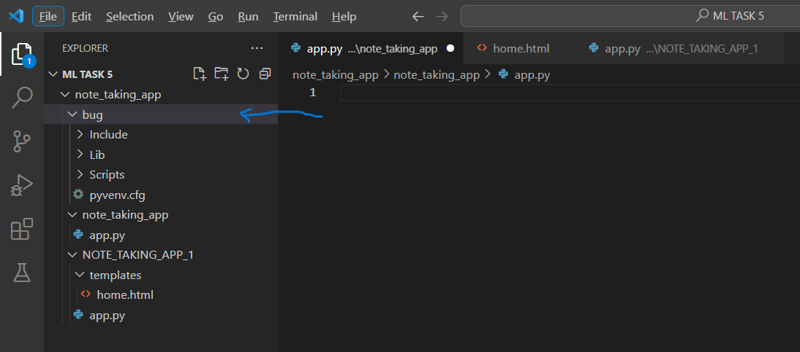
Steps for Code Refactoring and Bug Fixing:
Creating a Virtual Environment:

Slide 6
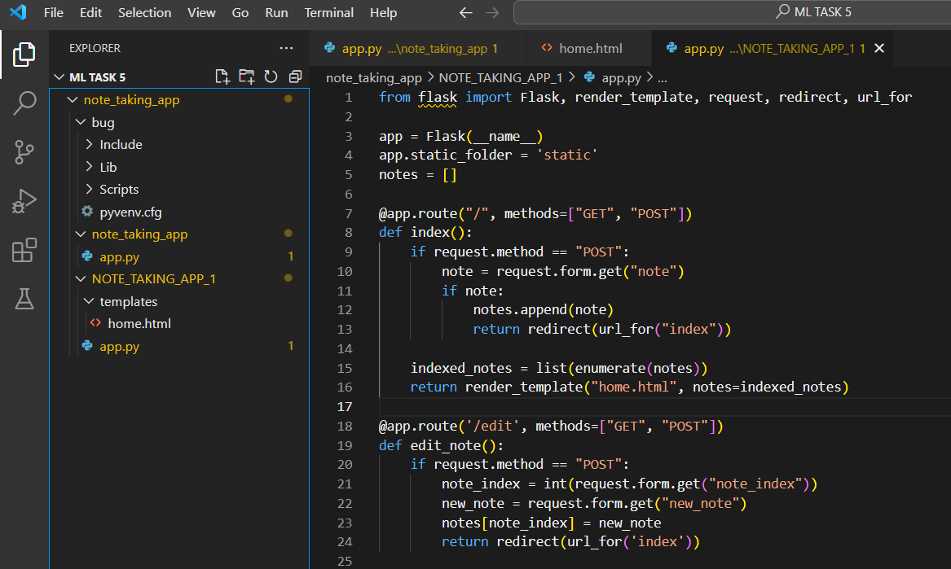
Identifying and Correcting Bugs in Python Code:
Note: This is just a sample code , You can find full python Code In my GitHub.

Slide 7
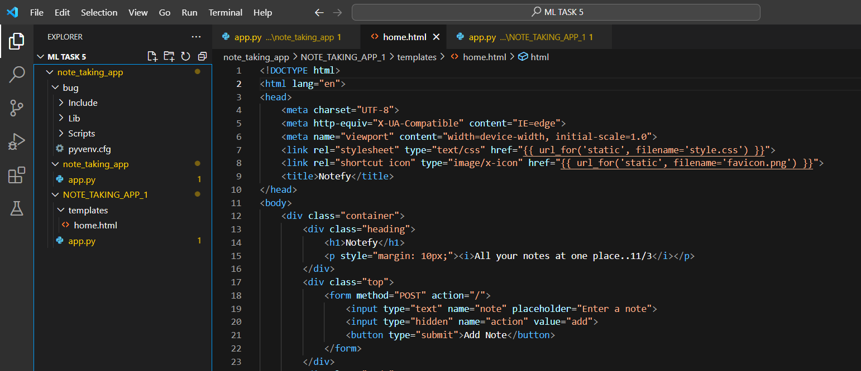
Identifying and Correcting the Bugs in the HTML Code:

Slide 8

THANK YOU

